Slide 1
Recursive sorting algorithms

Slide 2
Quicksort
Quicksort is a divide and conquer algorithm. Quicksort first divides a large list into two smaller sub-lists: the low elements and the high elements. Quicksort can then recursively sort the sub-lists.
The steps are:
Pick an element, called a pivot, from the list.
Reorder the list so that all elements with values less than the pivot come before the pivot, while all elements with values greater than the pivot come after it (equal values can go either way). After this partitioning, the pivot is in its final position. This is called the partition operation.
Recursively sort the sub-list of lesser elements and the sub-list of greater elements.
The base case of the recursion are lists of size zero or one, which never need to be sorted.

Slide 3
Quicksort
The "worker method" of quicksort is to process partitions
first, a pivot is selected (e.g. the middle element)
this pivot is moved to safety (i.e. to the far right)
all values that are larger than this pivot value are moved to the left
all values that are smaller than this pivot value are moved to the right
the pivot is then moved back into place
Processing a partition leaves the selected pivot in its final sorted position
The newly created partitions are then processed recursively using quicksort
Partitions are processed from left to right
processing the first partition produces a left and a right partition
processing the left partition produces a left-left and a left-right partition
etc
left partitions are processed until completion (i.e. partitions of one element)
There can be a large number of (unnecessary) pivot swaps for small partitions (e.g. 2 or 3 elements). These inefficient swaps can be optimized by using Insertion Sort.

Slide 4
Quicksort – pseudocode part 1
quicksort(array, left, right):
if left < right:
pivot := partition(array, left, right)
quicksort(array, left, pivot - 1)
quicksort(array, pivot + 1, right)

Slide 5
Quicksort : Pseudocode part 2
// left is the index of the leftmost element of the subarray
// right is the index of the rightmost element of the subarray (inclusive)
// number of elements in subarray = right-left+1
partition(array, left, right)
pivotIndex := choosePivot(array, left, right)
pivotValue := array[pivotIndex]
swap array[pivotIndex] and array[right]
storeIndex := left
for i from left to right - 1
if array[i] < pivotValue
swap array[i] and array[storeIndex]
storeIndex := storeIndex + 1
swap array[storeIndex] and array[right]
// Move pivot to its final place
return storeIndex

Slide 7
Merge Sort
Conceptually, a merge sort works as follows
Divide the unsorted list into n sublists, each containing 1 element (a list of 1 element is considered sorted).
Repeatedly merge sublists to produce new sublists until there is only 1 sublist remaining. This will be the sorted list.

Slide 8
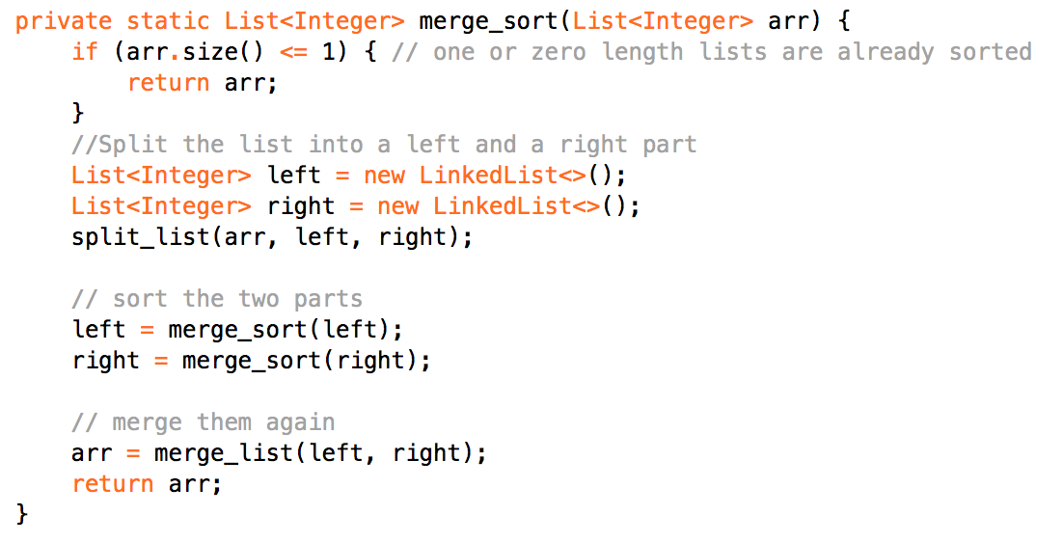
Merge Sort pseudocode part 1

Slide 9
Merge Sort pseudocode part 2
function merge(list left, list right)
var list result
while something left in both
if first of left < first of right
insert first of left into result
remove first from left
else
insert first of right into result
remove first from right
end if
end while
insert the remaining elements from left or right into result
return result

